Slide 1
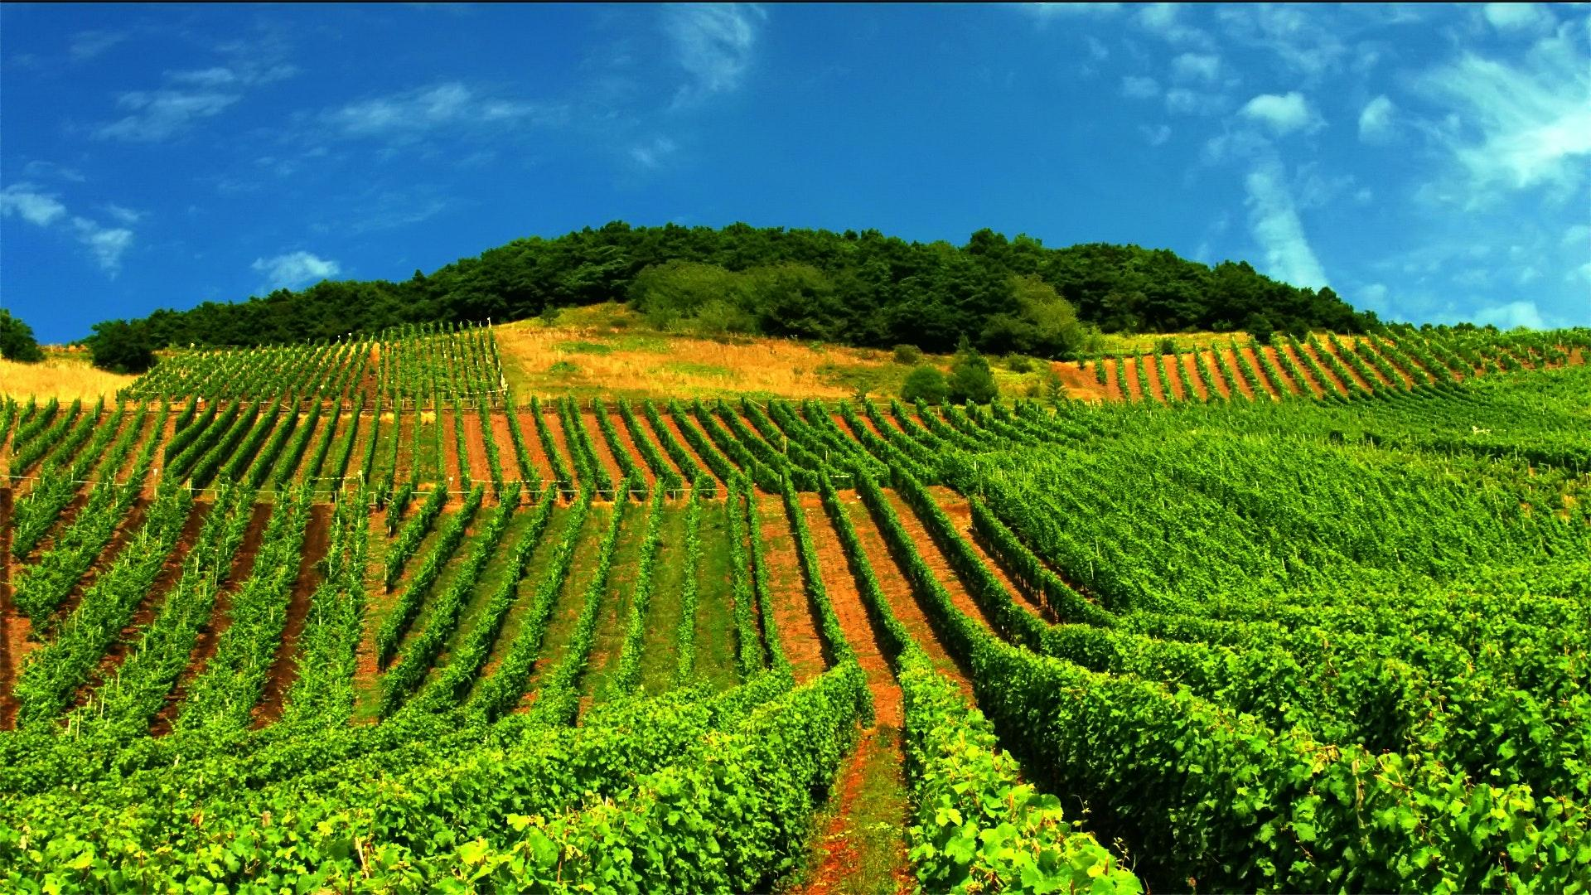
BlueBerry Winery Data analysis
Data analysis by:
Ele Cataldo
Chirag Patel

Slide 2

Theme
Graphical presentation of the provided data
Context
analyse,Discussion,explanation on quality of wine.

Slide 3
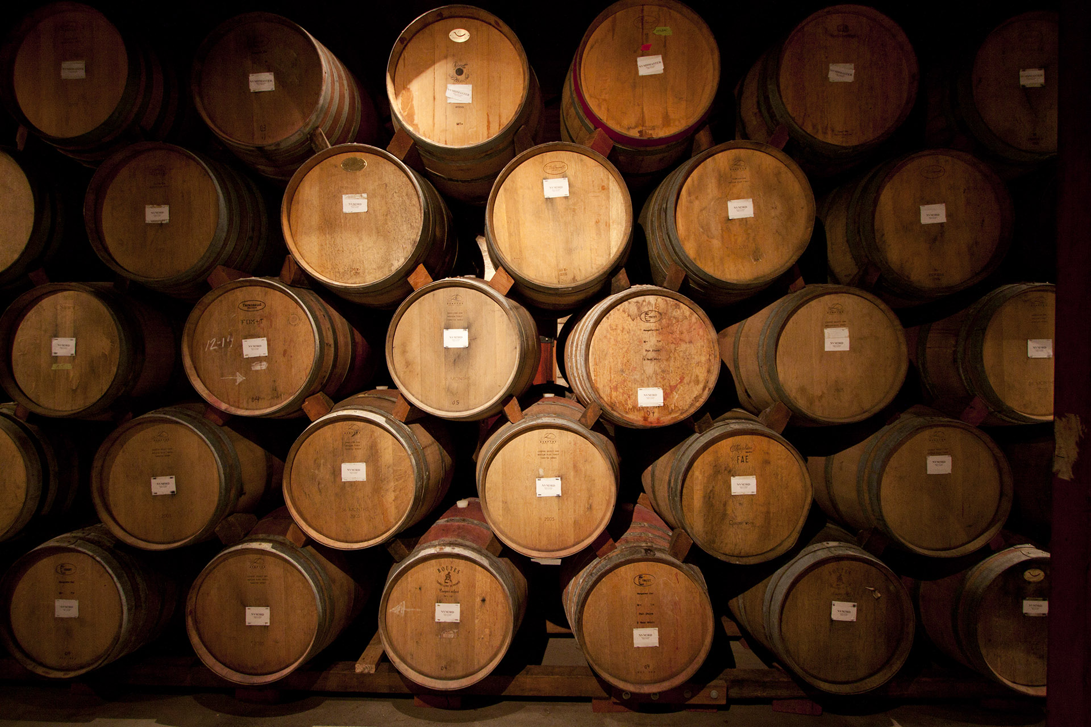
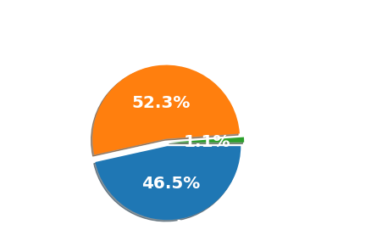
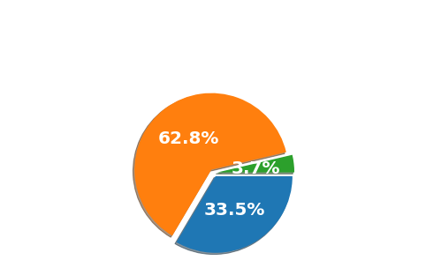

Slide 4


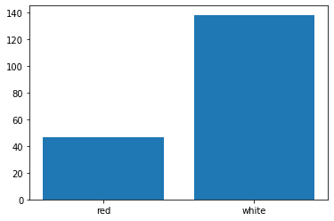
Total Sulfur Dioxide

Slide 5

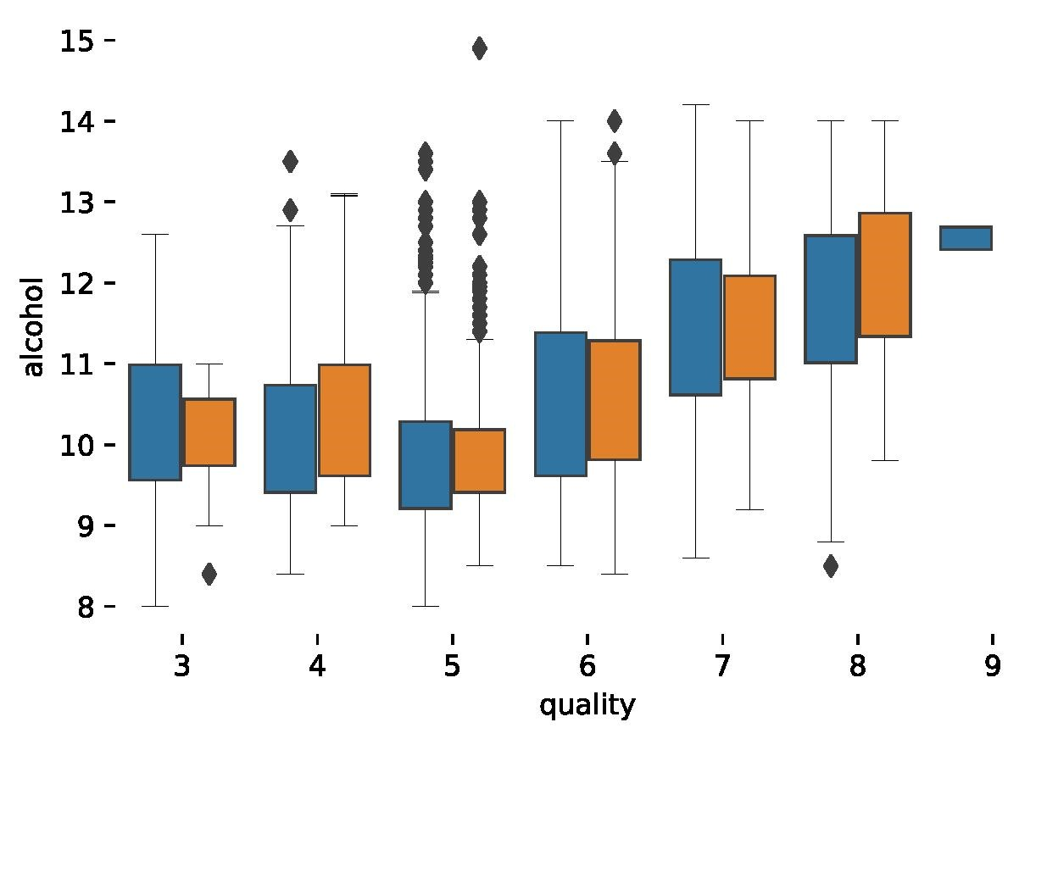
Boxplot: This Graph Basically analysis that, the better the quality of wine the higher the ratio of alcohol depending on the type of wine Red(Orange) or White(blue).

Slide 6
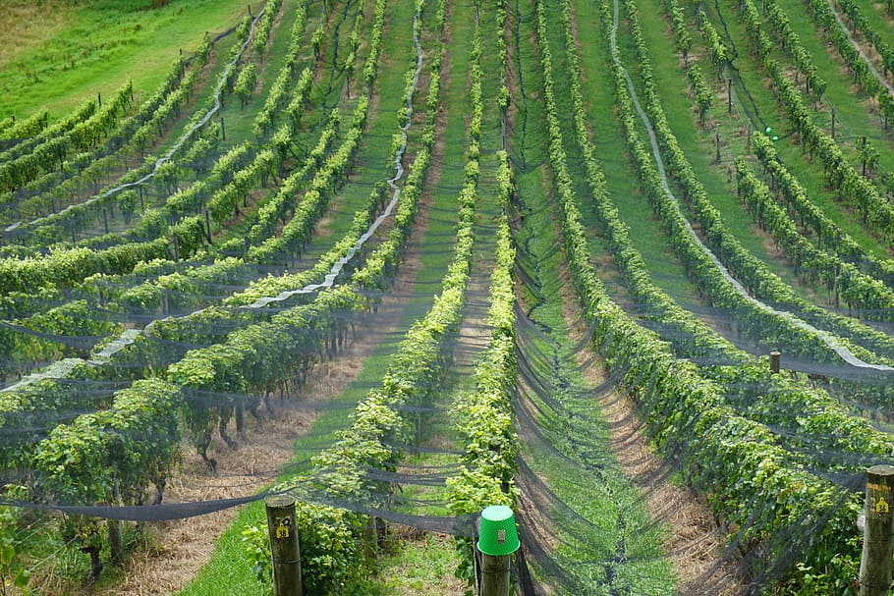
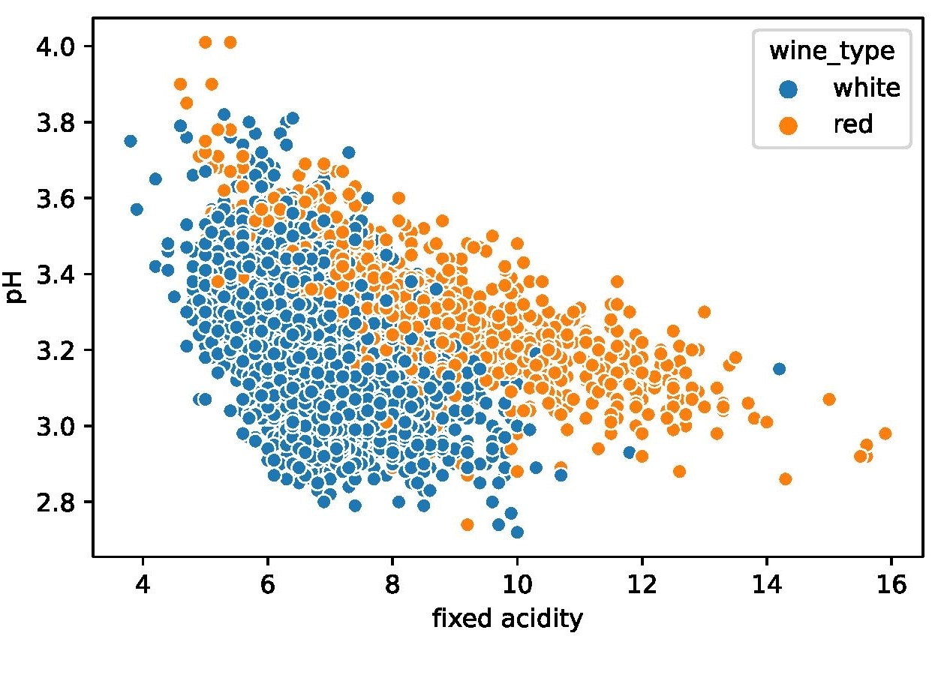
Scatter: This graph basically analysis correlation between Fixed acidity and Ph.
White wine : lower to medium Ph = Lower acidity.
Red wine: lower to medium ph = medium to high acidity.

Slide 7
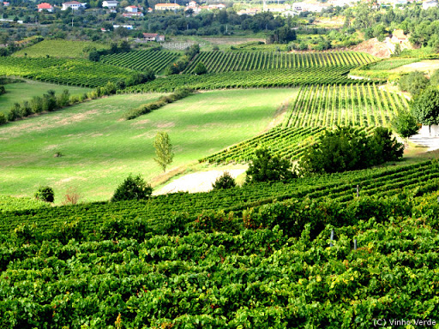
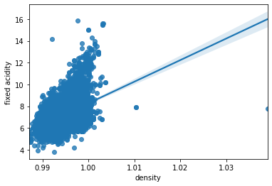

Slide 8
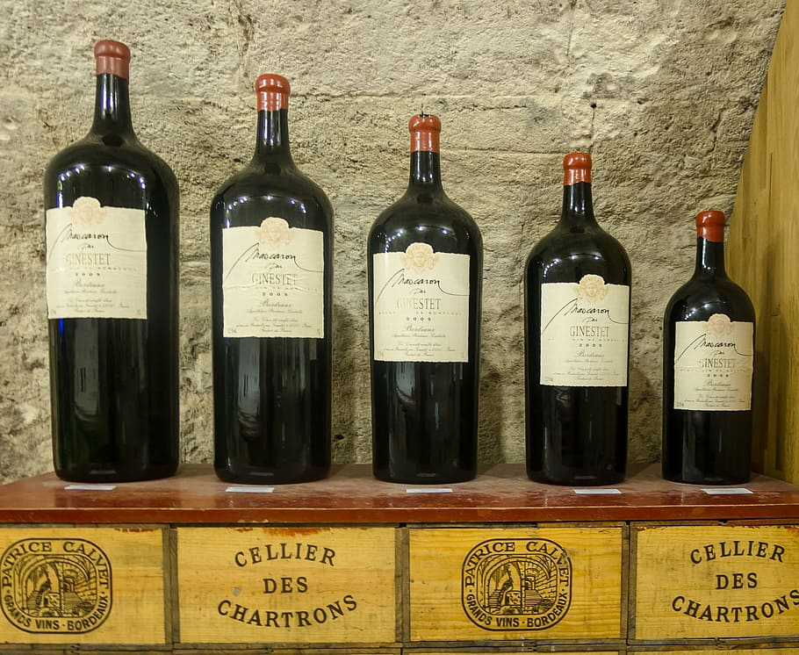
Conclusion of Data Analysis
So, from this presentation short. We Come to the conclusion that, that substances like alcohol,sulfur dioxide and pH influence the quality of wine. Which affects the overall composition the wine making it taste bad or better.

